Slide 1

Substitutions and Alternatives
Quick Guide

Slide 2

NEW - Product Availability Indicators
What do they Mean
 | Definition | What does this mean to you:
 | Product is in Stock and is available to order | Representative can order this item
 | Product is Low on Stock, but still available to order | Representative can order this item but stock is running low
 | Product is Out of stock - more stock is coming | Representative can select one of these options Select an alternative item from up to 3 options Elect to go onto back order for this item (an ETA is provided to show when we are expecting more stock to arrive ) Remove the item and order something else
 | Product is Out of Stock and is a limited edition or discontinued Item | Representative can select one of these options Select an alternative item from up to 3 options Remove the item and order something else
EXISTING
EXISTING – BUT NOW INDICATES THAT ITEM WILL COME BACK IN STOCK
ETA – Estimated Time of Arrival

Slide 3
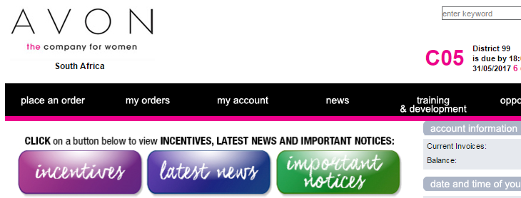
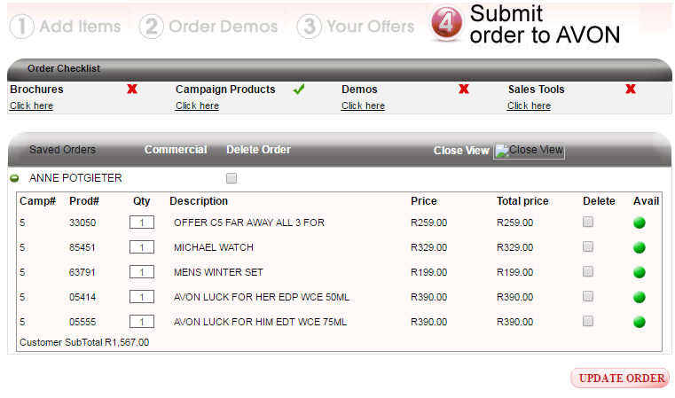
What will you see?
When placing an order on www.avon.co.za...
The AVAILABILITY buttons now come in 4 colours!

Slide 4
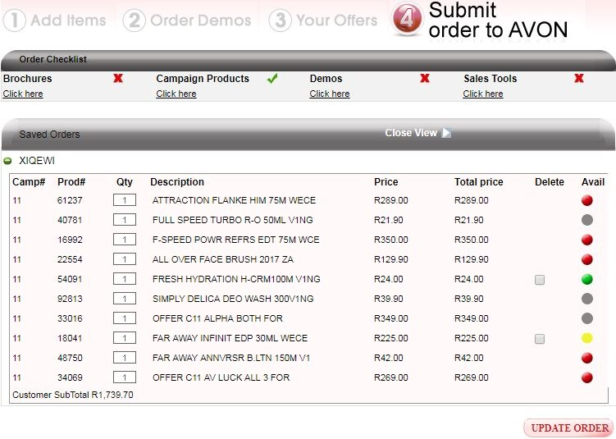
What will you see?
On the Order Summary screen:
You now have 4 colour indicators
Only GREEN and YELLOW items can be deleted.
RED and GREY items must be actioned
You MUST action this screen before you can continue with your order
When you click “CONTINUE” a pop-up screen will appear

Slide 5
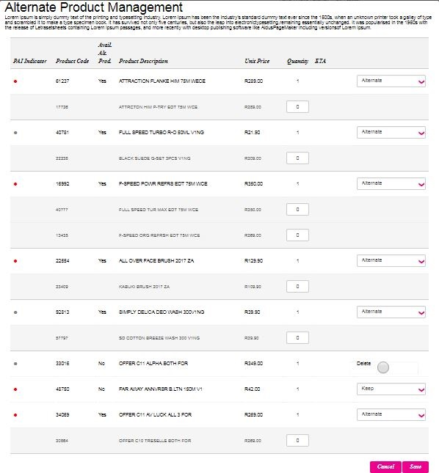
What will you see?
If you have RED or GREY buttons on your order:
you can REMOVE from the order
you can KEEP & put on back-order
you can choose an ALTERNATIVE if
available
you can REMOVE from the order
you can choose an ALTERNATIVE if
available
You MUST action this screen before you can move on with your order
If no ALTERNATIVES are available, only the REMOVE and KEEP options will show

Slide 6
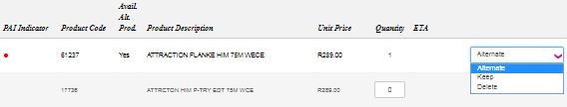
What will you see?
Grey – alternative available
Grey – no alternative available
Red – alternative available

Slide 7
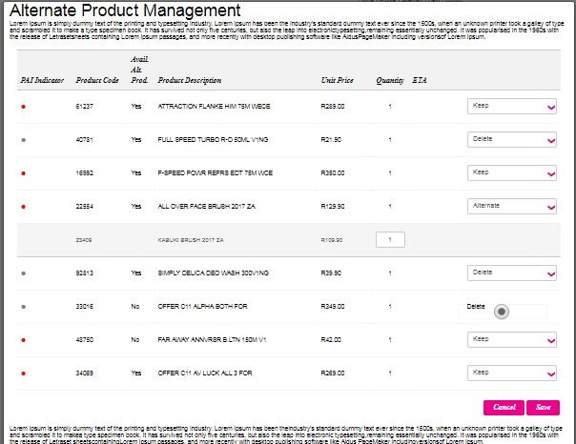
Your screen will now update as per your selections, and you SAVE to continue with your order

Slide 8
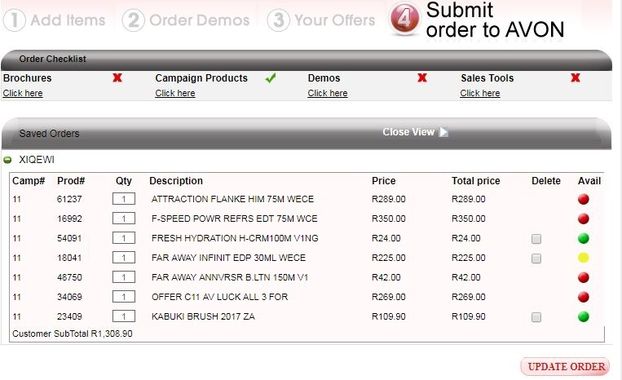
What will you now see?
On the Order Summary screen:
Your Order Summary is now updated as per your selections

Slide 9
Isn’t this great?
No more unwanted products which you didn’t order!
No more lost sales due to out of stocks
Immediate visibility of what’s in and what’s not
Choose your own substitutions!
Fewer returns and credits
More happy customers

Slide 10
Thank you!

