Slide 1

Mobile App Training Guide

Slide 2
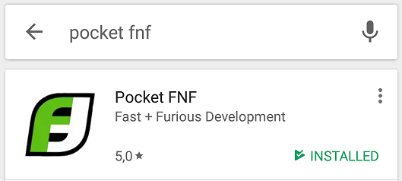
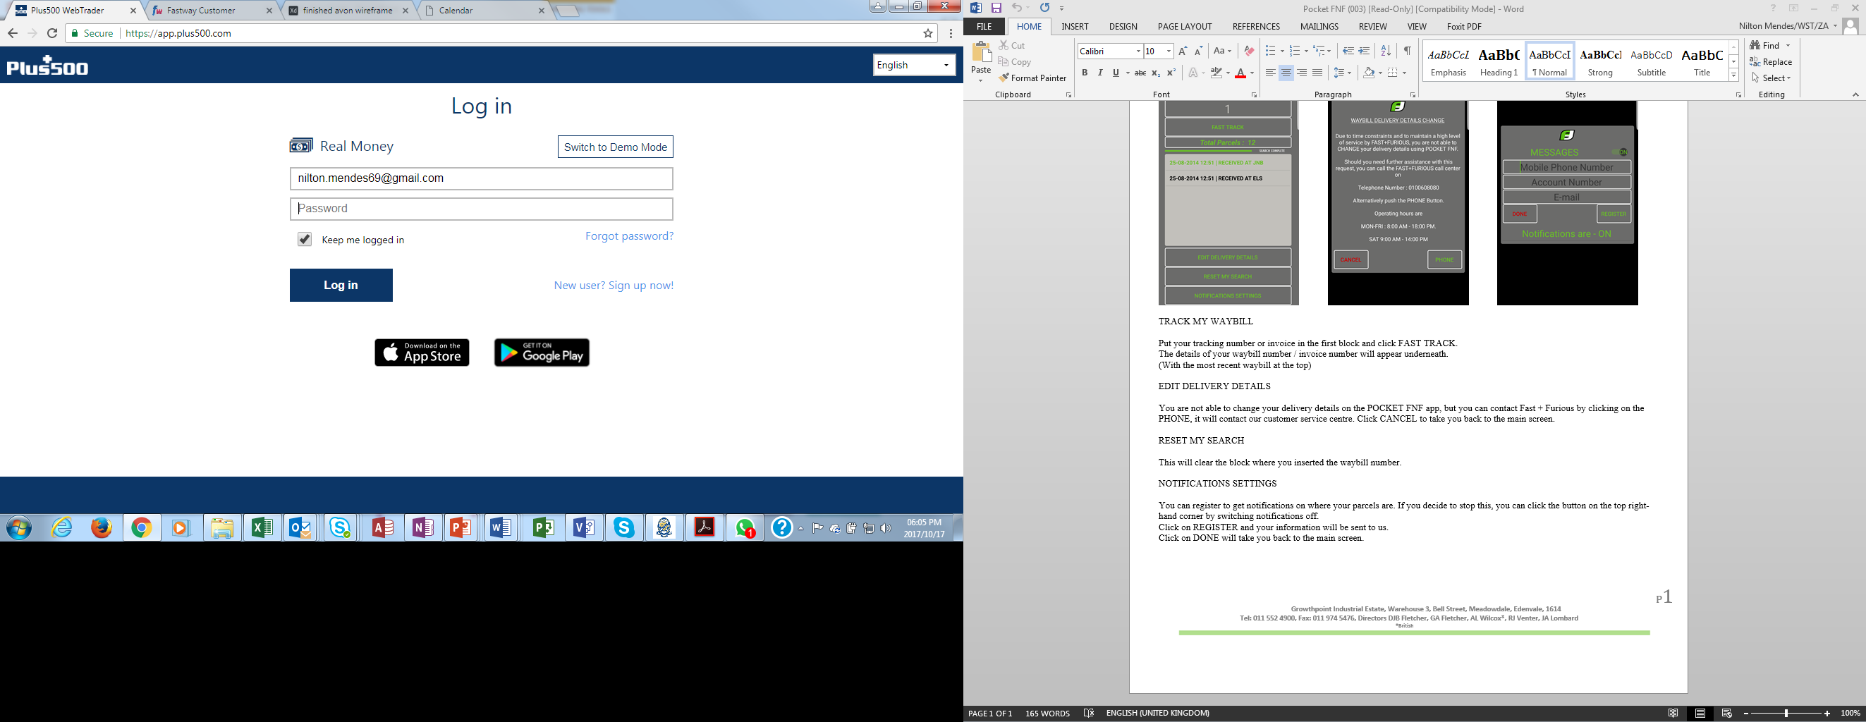
How to install the FNF Mobile App
Step 1:
Download the FNF App from the ‘App Store’ or
‘Google Play’ Store
Step 2:
When the store is open, search for ‘Pocket FNF’
Step 3:
Click the ‘Install’ button
Successfully installed

Slide 3
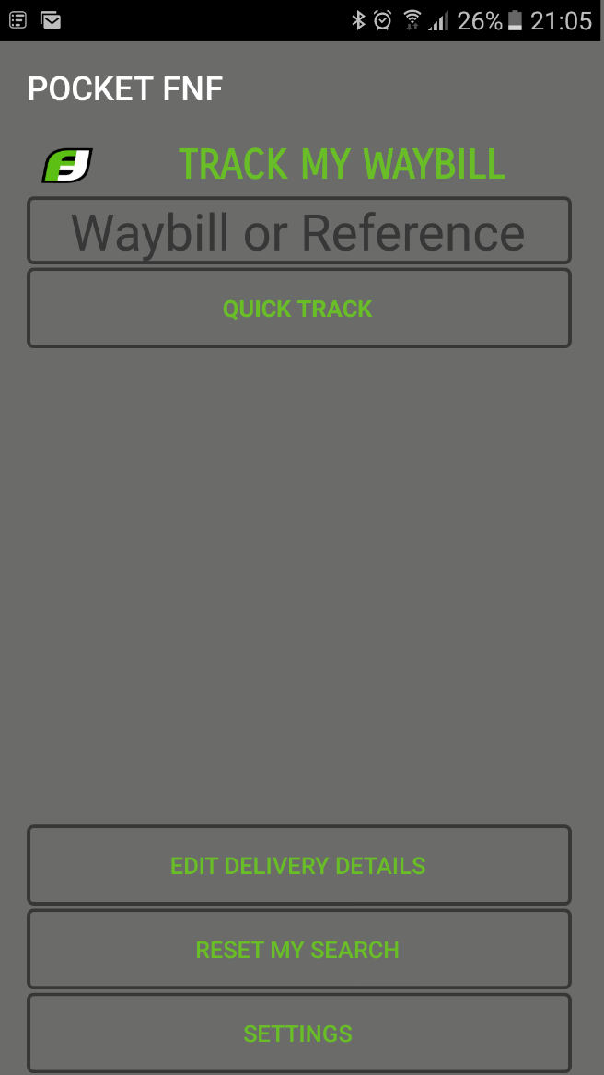
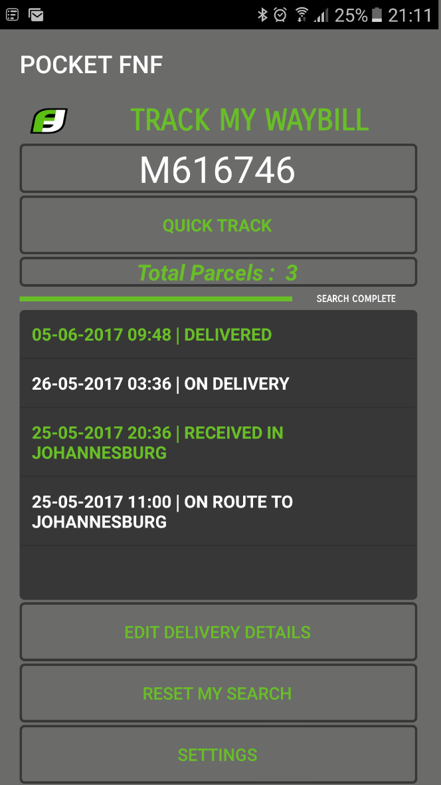
How to use the FNF Mobile App
Open the FNF Mobile App
Type your Invoice # and click ‘Quick Track’
Type in your Invoice # here
Then click here
This is the landing page
In this section you will find the updated location of your box

Slide 4
Important points to remember
Open the FNF Mobile App
Edit Delivery Details:
You are not able to change your delivery details on the FNF Mobile App, but you can tap on ‘PHONE’ and update your delivery details by speaking to a Contact Centre Agent.
Click ‘CANCEL’ to take you back to the main screen
Reset my search:
This will clear the last invoice number you entered.
Settings:
Register to receive tracking notifications of your order.
By clicking on ‘REGISTER’ your information will be sent to us.
By clicking on ‘DONE’, you will be directed back to the main screen.
To deactivate notifications, click the button on the top right-hand corner: ‘Switch notifications OFF’.

Slide 5
Thank you

