Slide 1
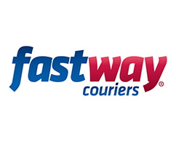
Mobile App Training Guide

Slide 2
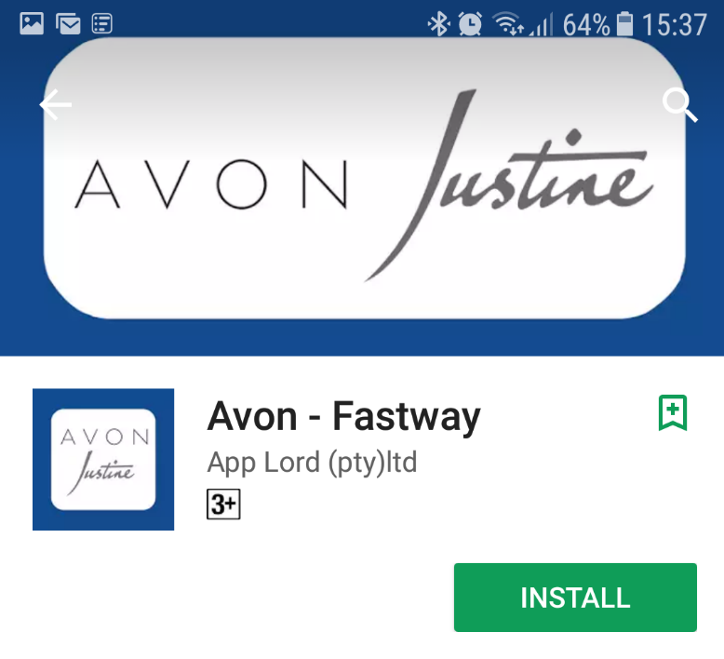
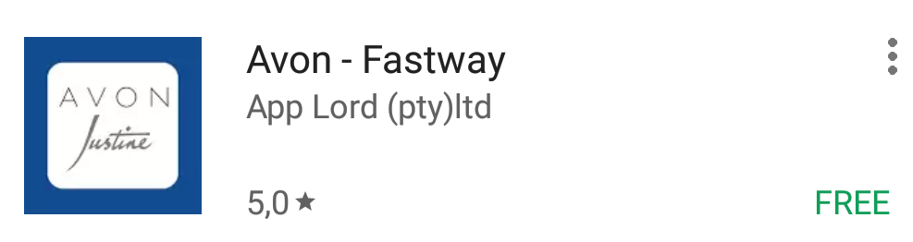
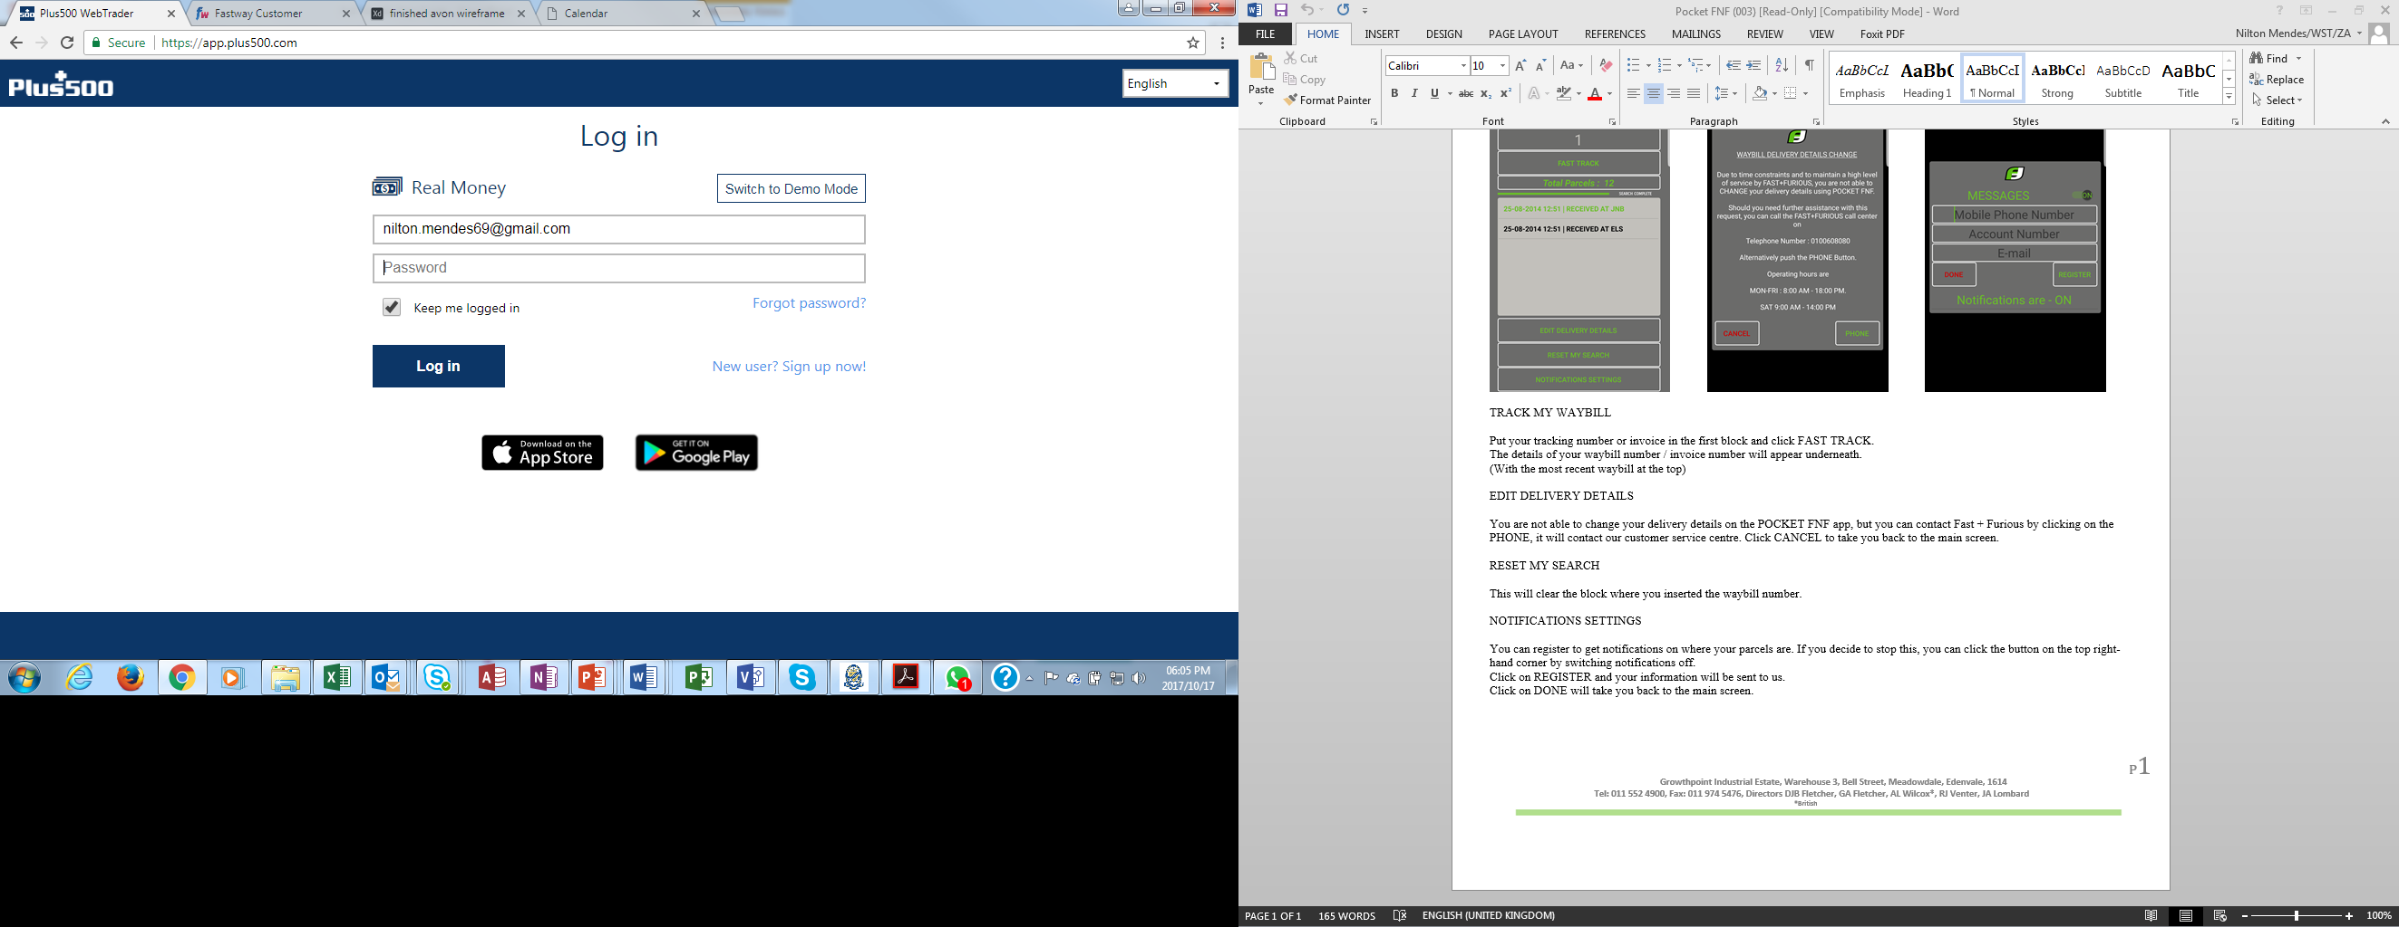
How to install the Fastway Mobile App
Step 1:
Download the Fastway App from the ‘App Store’ or
‘Google Play’ Store
Step 2:
When the store is open, search for ‘Avon - Fastway’
Step 3:
Tap the ‘Install’ button

Slide 3
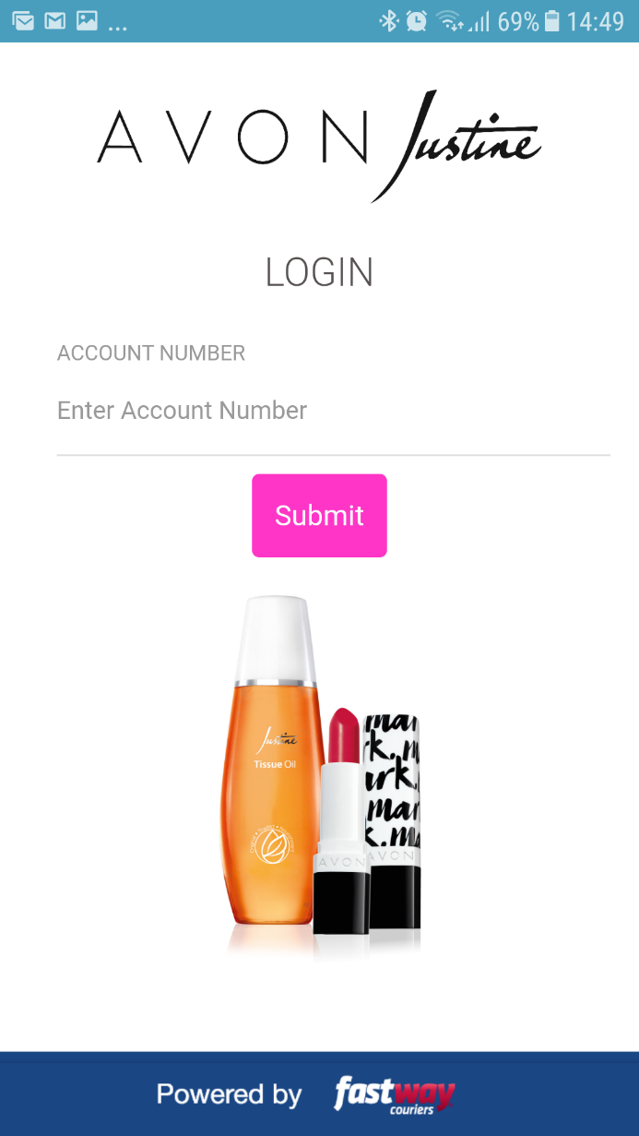
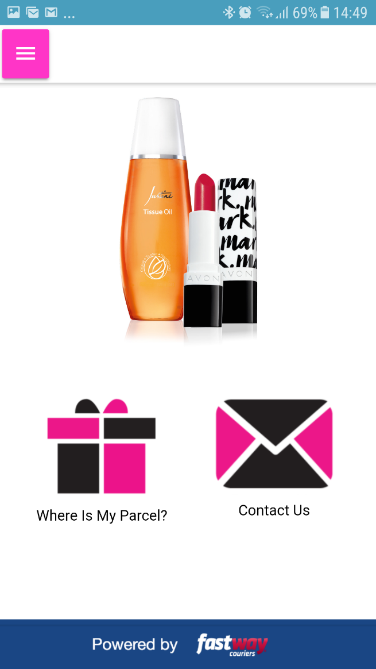
How to use the Fastway Mobile App
Step1: Open the Fastway Mobile App
Step 2: Track your parcel
Type your account number and tap on the ‘Submit’ button
Should you wish to contact us please tap on the envelope for relevant contact details
Tap here to track your parcel

Slide 4
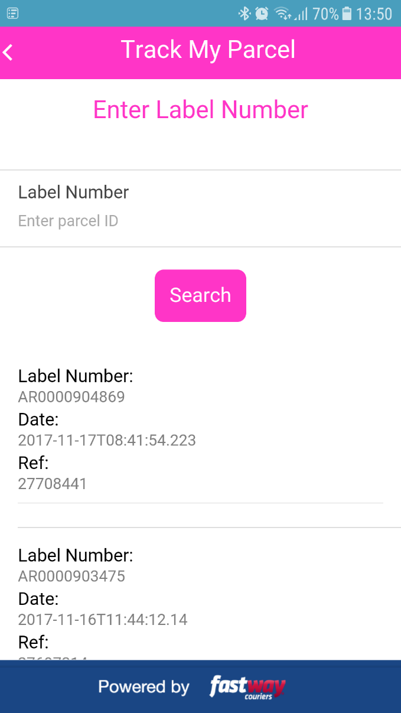
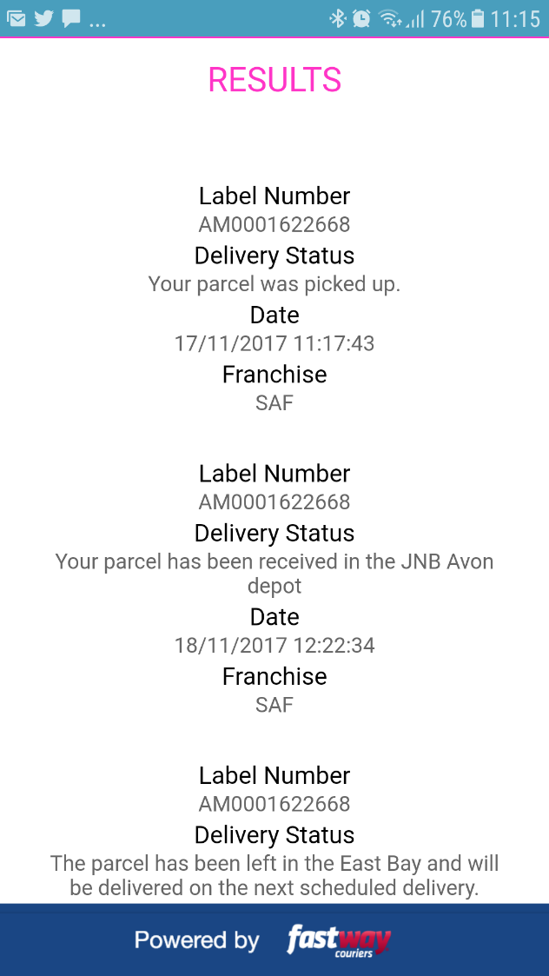
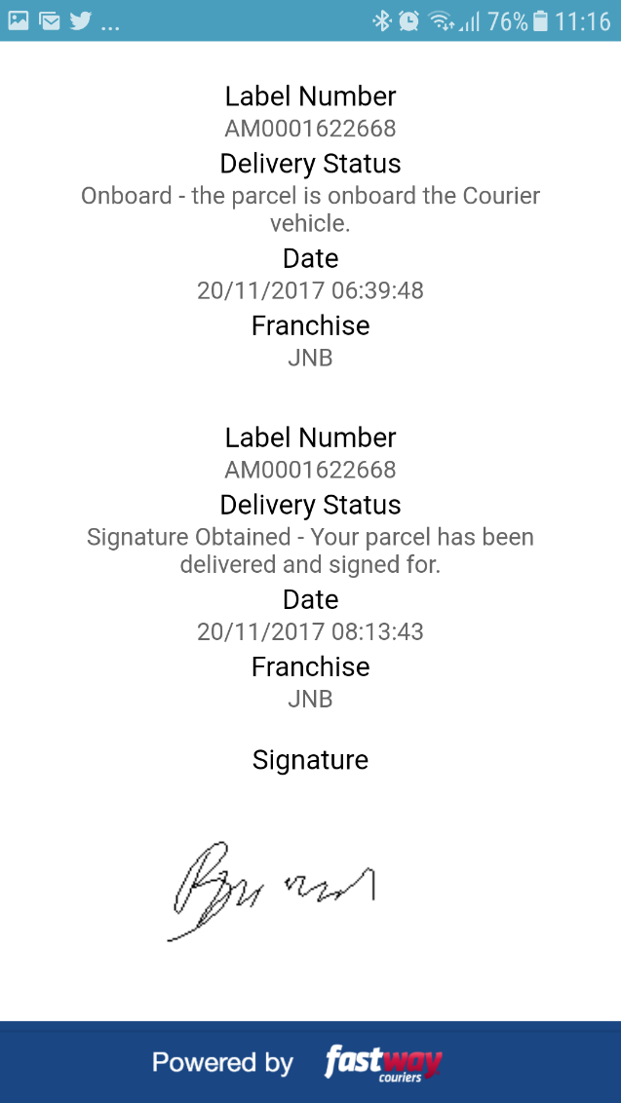
How to use the Fastway Mobile App
Step 3: Tracking current
and older orders
Step 4: Detailed tracking location of your order is displayed
If you would like to track orders older than 10 days, type your ‘order number’ in here and tap on the ‘search’ button
If your order has been delivered, the receiver's signature will be displayed
To track current orders, tap here

Slide 5
Thank you

