Slide 1


How to Successfully MANAGE your AVON BUSINESS as a:
“Pay-as-you-Go”
Representative

Slide 2

So you have a
“Pay-as-you-go” account, what does that mean?

Slide 3
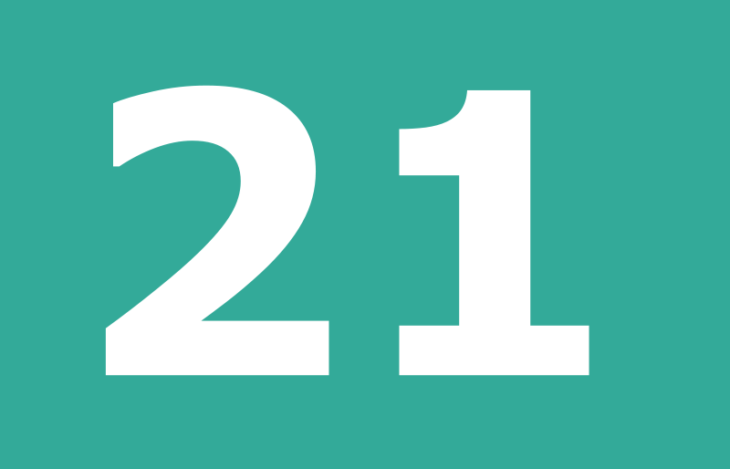


In Avon you get 3 Type’s of Accounts
21 Days - Credit limit (R1250)
“Pay-as-you-go” – No credit pay for your order before it can be delivered
Deposit to buy – you have the following options if you are a deposit to buy:
Pay R300 = R750 credit (once off)
Pay R500 = R1 250 credit (once off)
This will allow you to place orders up to the value of that limit. If your order exceeds your limit, Avon will request you pay the difference before delivering your order to you. After your payment reflects, your order will be invoiced and delivered to your delivery address.
Notes:
Discuss the 21 days and the starting credit limit of R1250 explain the increase of Credit limit
Discuss Pay as you go – Discuss the fact that even if they start out as a pay as you go that they can become a 21 day account
Explain the permanent pay as you go
Remember the difference between the 2 is only 20 days! Not even a month! Well know direct selling companies like Tupperware, Vanda and Avroy etc is strictly CASH!

Slide 4

Difference between PAYG, 21 day Account, Deposit to Buy
“Pay-as-you-go”
21 Day Account
Deposit To Buy
No Limit
Collect order from customer with payment upfront or collect deposit
Use your own money
Pay Avon for your order before it will be dispatched
Deliver products, collect 2nd order and cash upfront continue with your business
Credit limit R1250
You have up to 21 days to pay
Order process
Make your delivery
Collect money
Pay Avon and yourself on time.
Place your next order continue with your business
Pay your deposit to buy credit
Remember your order will be deleted after 21 days if your deposit has NOT been paid
Order process
Make your delivery
Collect money
Pay Avon and yourself on time.
Place your next order continue with your business
Notes:
Read through the slide

Slide 5

Make being a “pay-as-you-go” account work for YOU!
CASH is QUEEN!
Start your business and set the expectation of COD!
Let your Customers pay a 70% deposit for their order
Start selling to your family and friends first!
Let your customer pay the money into your Avon account
No held orders
No limit
Build your Customers trust
Become a President Club Member – it’s up to YOU!
Take up our next opportunity and join Leadership
Notes:
CASH is QUEEN!
With cash you will always be paid immediately – no hassle to get they money from your customer
Make sure that you call on her round her pay date
Utilize you customer calling book to make sure you service all your customers by giving them a brochure and to enable them to place a order every month
NO LIMIT
Having a cash call account means that you can sell for as little (R350) or as much as you want!
BUILD YOUR CUSTOMERS TRUST
Make sure that you deliver a service that is regular, prompt and always buy demo’s to grow your customer spend and to keep her best interest at heart

Slide 6
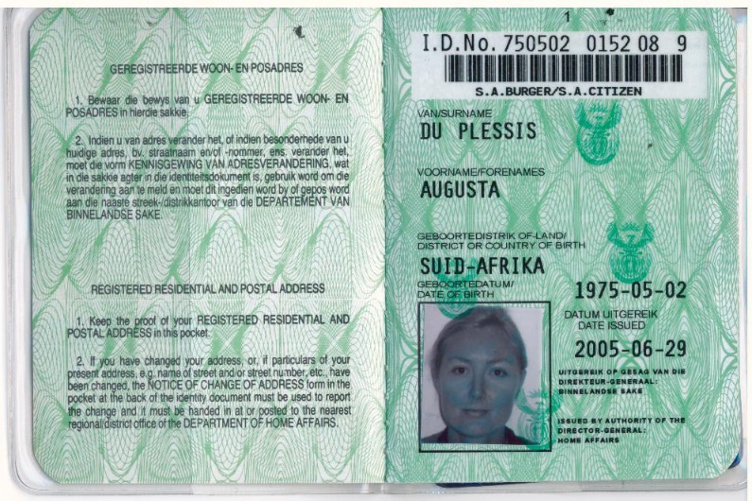

Your ID is linked to you and it will follow you where ever you go, start TODAY to build a credit record!
Notes:
Make the statement that they can work on their credit record – make this a fun statement like a new beginning

Slide 7

First steps to start your business ?
Start the Conversation
Answer questions
Tap into Customers needs
Tell her what you have
Get the Order
Collect the money
Confirm delivery date
Notes:
Role play the conversation between Pay as you go Representative and a new customer Have a prize for best pair!

Slide 8

Selling to your customers – features, advantages & benefits
What motivates people to buy?
Feeling good
Saving money
Saving time
Convenient
WHAT’S IN IT FOR ME??
The answer is always a benefit!!!
Notes:
Ask the delegates to think of a recent purchase and what made them buy?

Slide 9


Continue to grow your business
Place weekly orders to maximize your earnings potential
Deliver, collect money for next order and continue to earn
Use discount earned to build up cash flow to assist you with paying upfront

Slide 10

Achievement of Dreams
Current Brochure
INSTANT CASH IN
YOUR
POCKET
Collect Customer Order & Money
Deliver order to customer
Sell! Sell! Sell!
C A S H
Notes:
These Field Fundamentals are:
Prospecting
Appointing
Training
Developing
You will also learn about supporting skills:
Communication
Listening
Selling actions
There are two sets of measures that Avon Justine uses to determine if you are achieving excellence in the performance of Field Fundamentals.
First, are you exhibiting the specific competencies that are the basis of Prospecting, Appointing, Training and Developing?

Slide 11




Congratulations on your PAYG Avon Account
Please collect your Customers money for their orders
Deposit the money into Avon’s account
Send a picture of the Deposit slip via sms/whatsapp the number you received this message from
Receive your order and deliver your Customers order with a new Brochure and collect your next order with her money
Tips:
Sell to at least 2 Customers at
a time. Remember the min
order value is R450
Try to place small orders
Collect money when you
collect your order
Pay before you place the
next order
Order every week

Slide 12
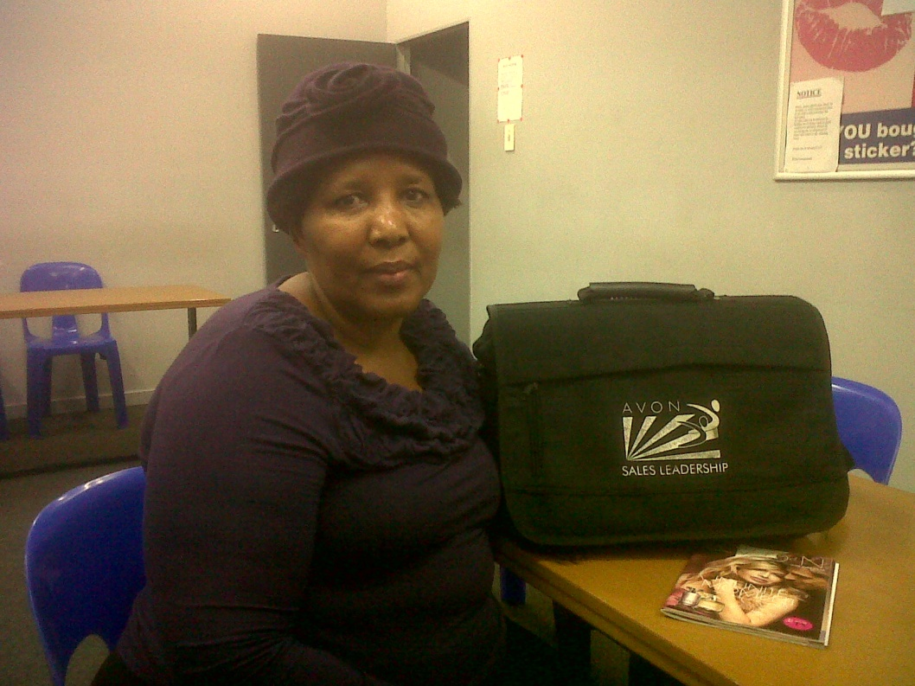
Pay as you go success story…….
MAGDELINE MASHILE
I started my business 10 years ago with Avon , 7 of those
years I was as a Cash Call account.
Today at the age of 60, I am a successful EUL, Why?
I wanted to earn extra money and made the decision to become a GSL. I used my money to pay for products and brochures. When my customers
placed their orders I used my commission to pay into my Avon account When I receive the products I delivered it to my Customers immediately and collected their money, they knew I work on a COD basis only.
I extended my house, adopted a baby girl,
she was 1 year 3 months old, today she is 8 years and I am
Still looking after her with my Avon money. When my son was in hospital I paid R4800 towards his medical bill.
Avon has now given me a 21day account, I am grateful to Avon for giving me the opportunity

Slide 13

“With Avon you have several opportunities, each having a different potential earnings range. The more specific you are with what you would like to earn, the easier it is to match you with the right opportunity.”
Cash is the
Notes:
What = goal
How = Actions
Remember – focus on ACTIONS – what actions will you need to take to recruit more people? What actions will you need to take to increase your team’s sales?
See if you can draw up a quick action plan that you can take away to help you reach your goal

Slide 14
Thank you!

